Slide 1
An Arduino-based instrument for more intuitive expression of electronic music
Tina Wang u6076893 Supervisor: Ben Swift
Research School of Computer Science COMP3770
Monday 30th July 2018

Slide 2
Introduction
How can we make electronic music more intuitive to play & create?
Seek a deeper understanding of relationship between technology and music
Push the boundaries of how we currently engage with and produce electronic music

Slide 3
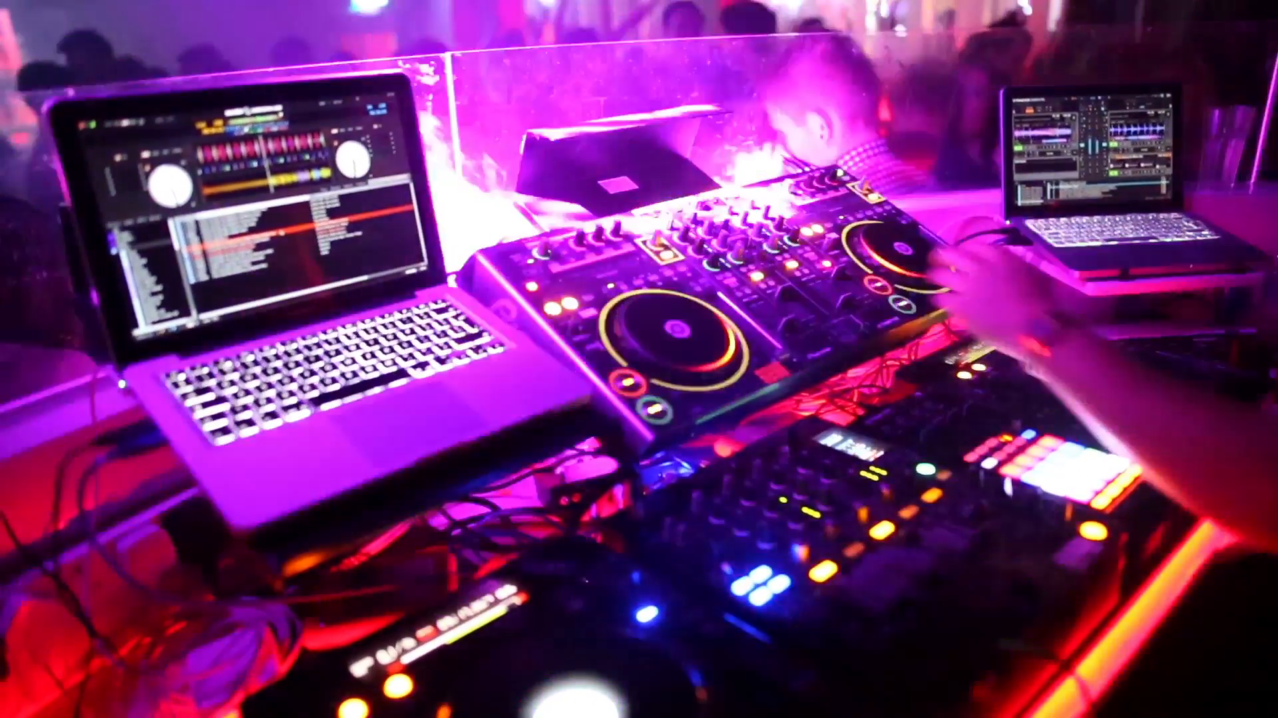
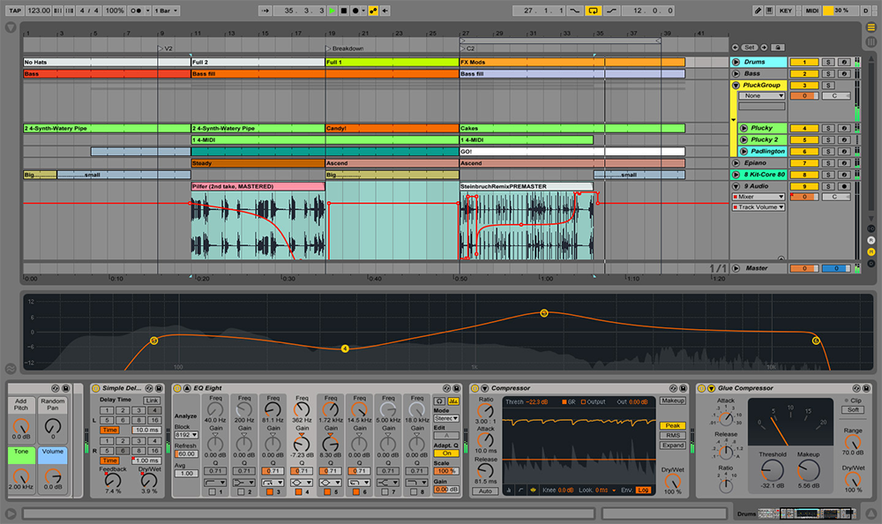
Motivation
Existing electronic musical production – are they intuitive?
Not particularly – more accessible instruments needed

Slide 4
Goal
To create a more intuitive electronic music instrument without compromising too much on expressivity

Slide 5
Background
NIME – New Interfaces for Musical Expression
Inspiration
Development
Evaluation
Arduino
Inspiration
Development

Slide 6
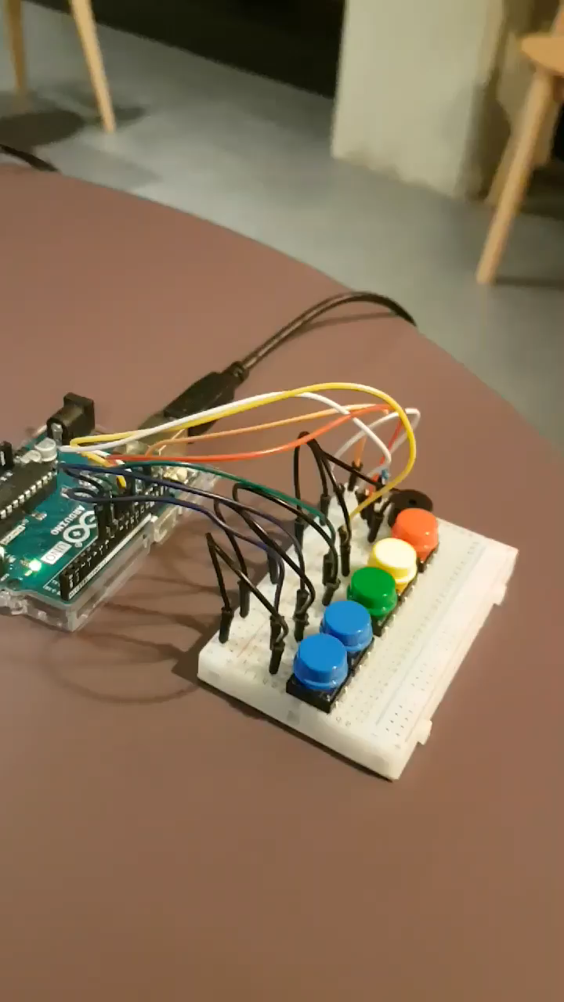
Preliminary Results
Built an Arduino mini-piano
Getting familiar with Arduino

Slide 7
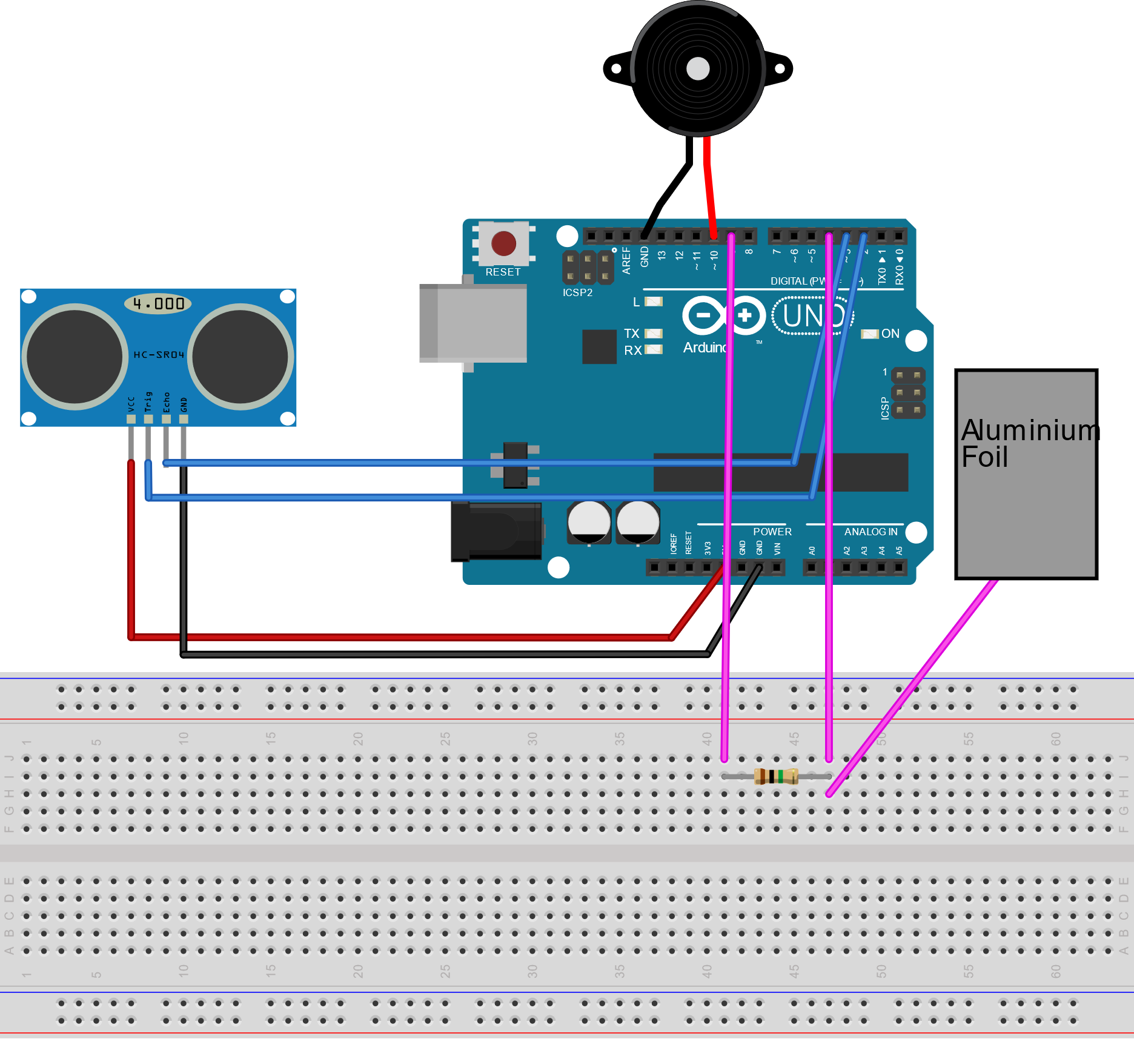
Approach
Future Direction: Continuous sound & Percussion element

Slide 8
Approach

Slide 9
Approach
3. Buzzer
2. Ultrasonic Sensor (Percussion)
1. Capacitive Touch (Continuous Sound)

Slide 10
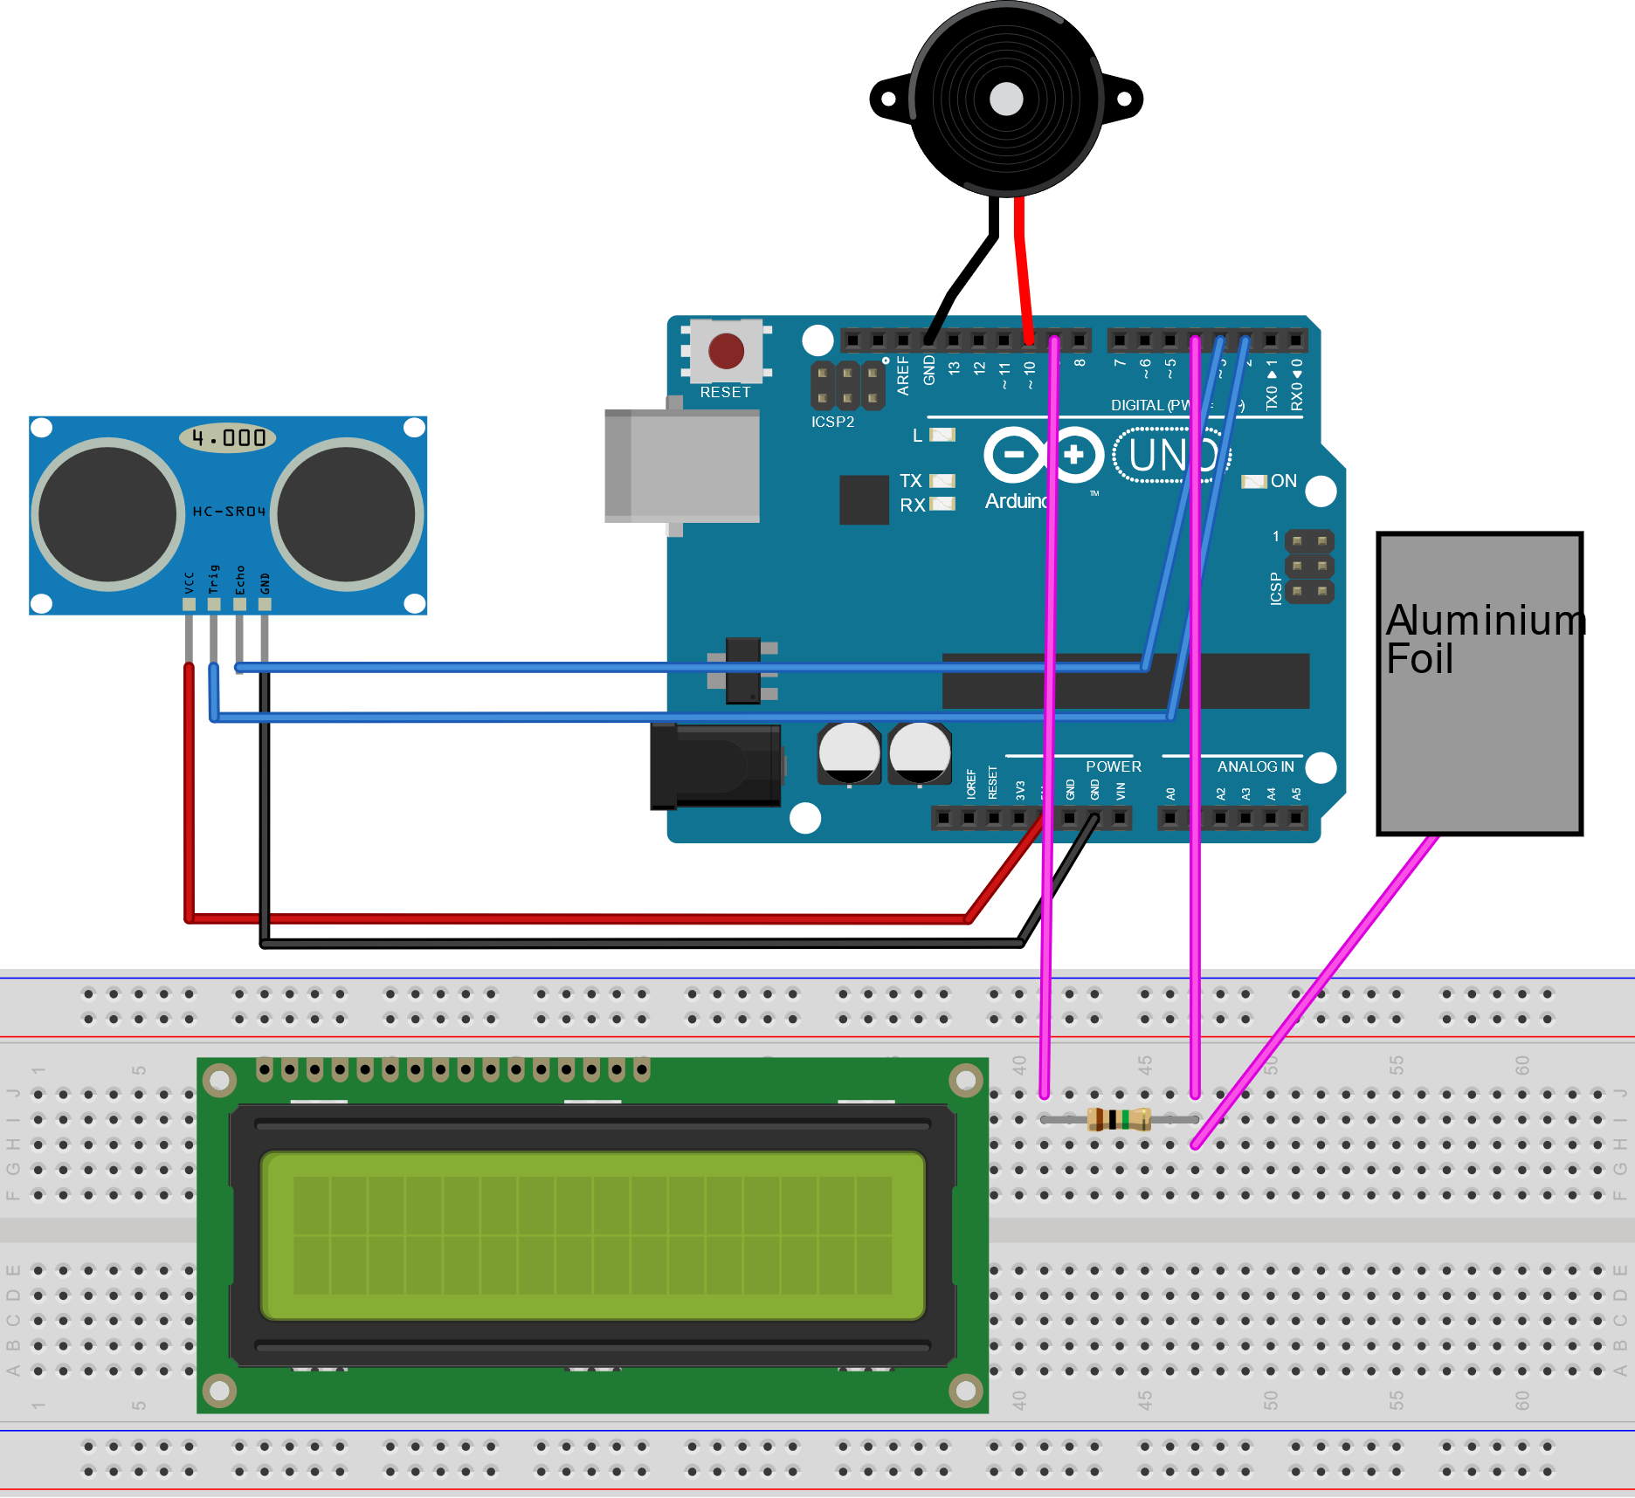
Approach

Slide 11
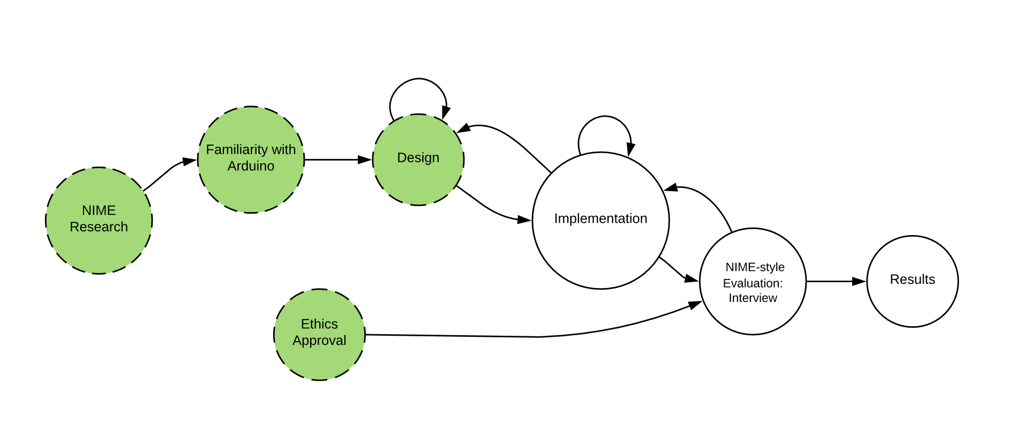
Roadmap

Slide 12
Conclusion
Seeking to create a more intuitive instrument for electronic music expression
Hopefully, multiple paradigms of musical expressivity will be accounted for (e.g. percussion, continuous sound, volume)
Evaluation: NIME-based Interview-style

Slide 13
Thank you!

